Slide 2
Kitty Nijmeijer

Slide 3


Slide 4

Linear economy
Resources

Slide 5
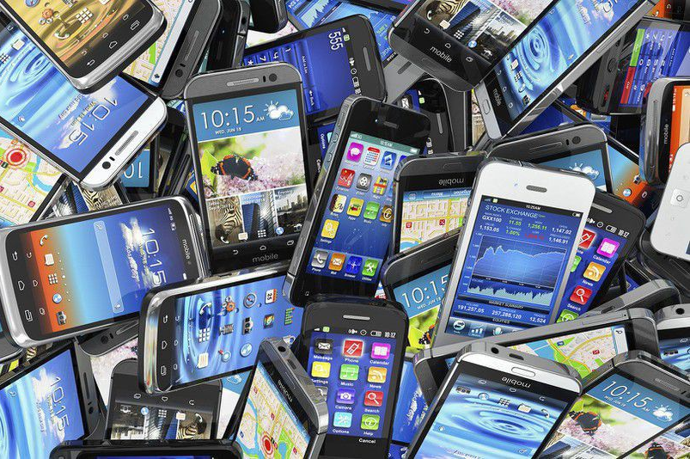
Linear economy
Resources
Products

Slide 6
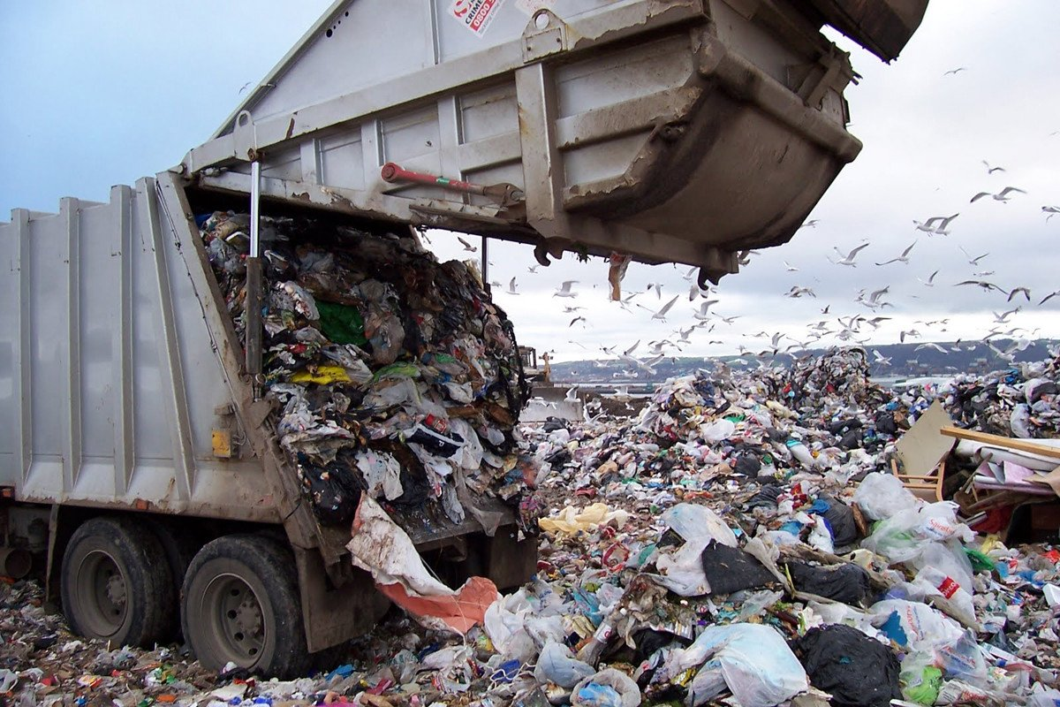
Linear economy
Resources
Products
Waste

Slide 9
Solar energy
CO₂

Slide 10
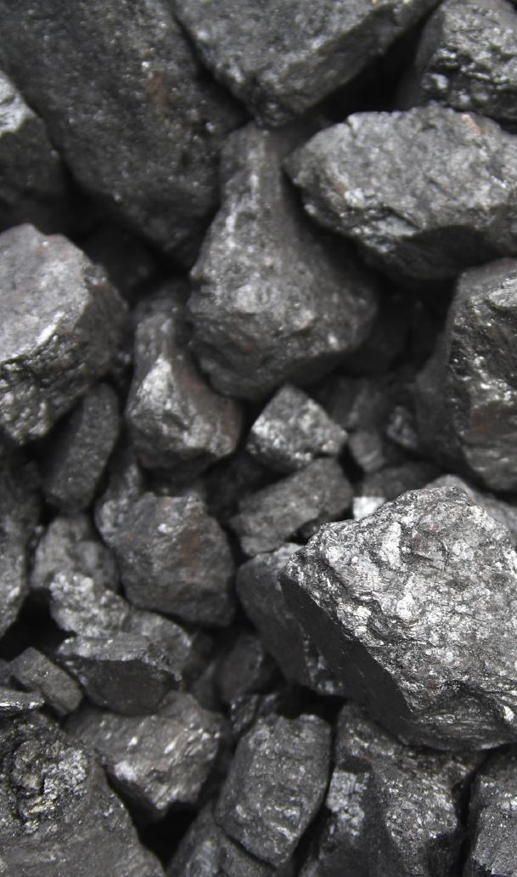
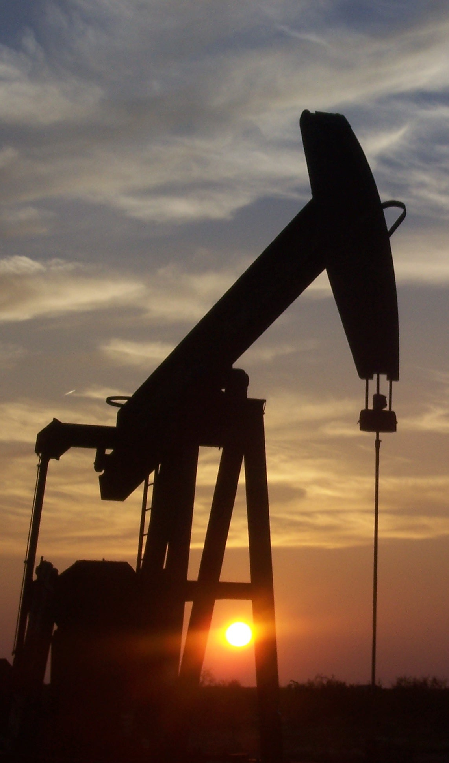
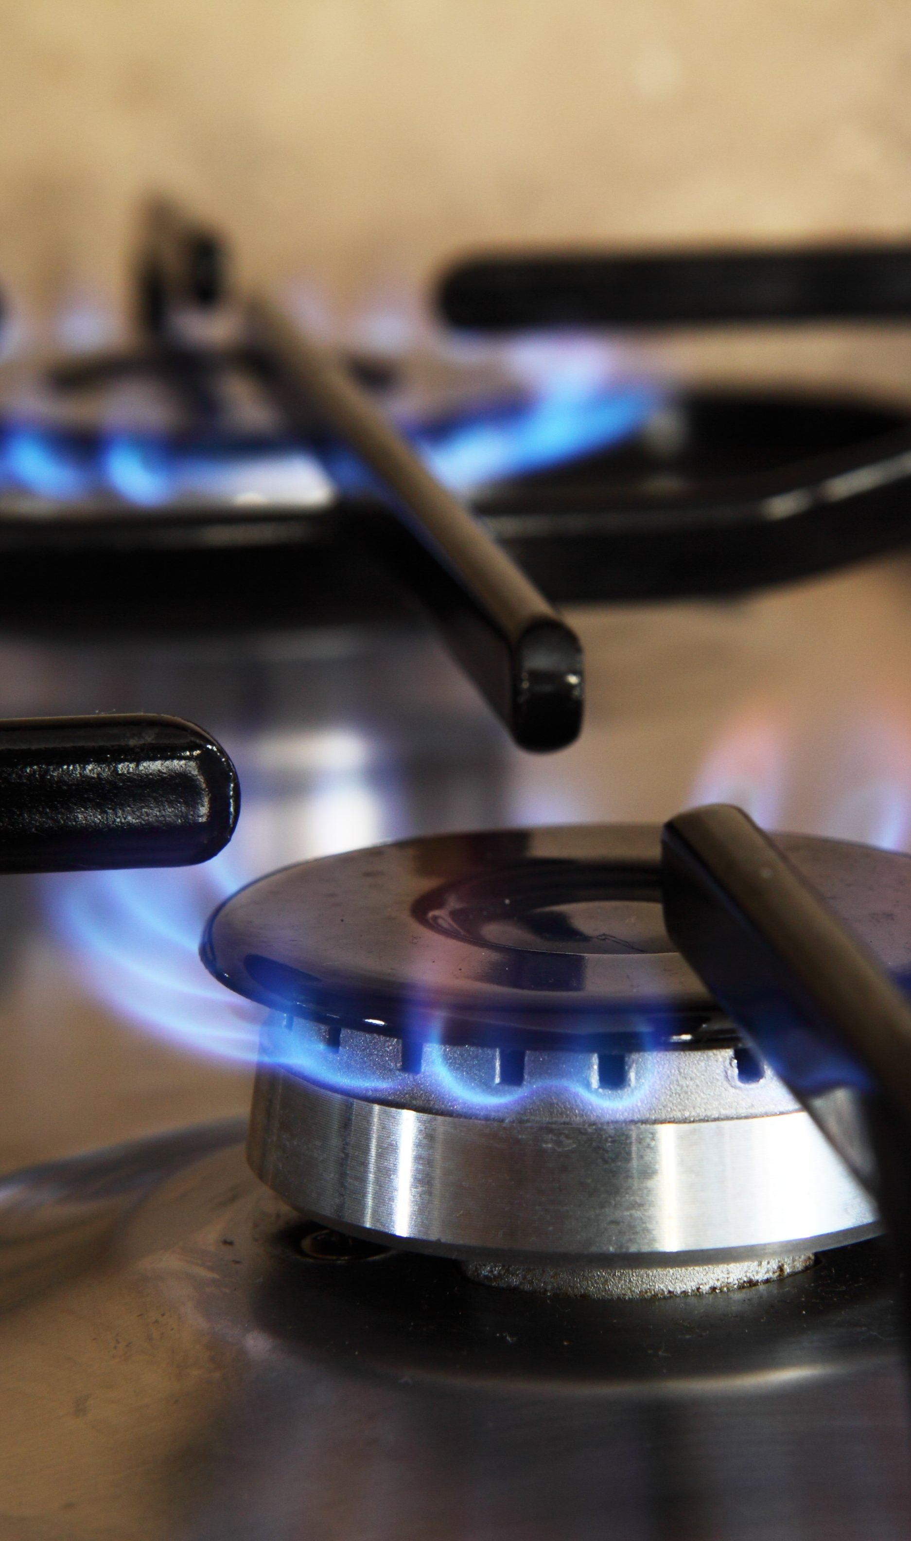
Solar energy
CO₂
Fossil
fuels

Slide 11
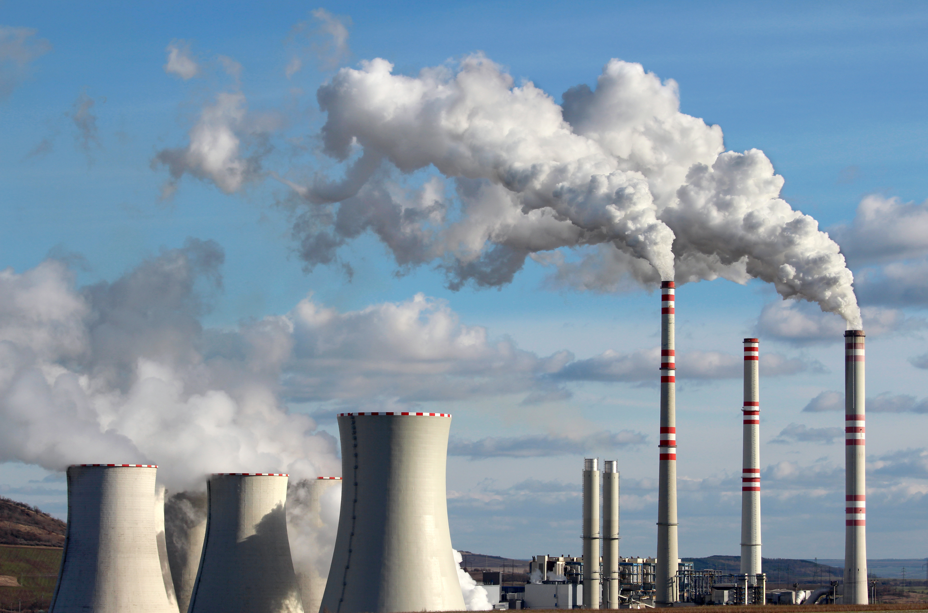
Solar energy
CO₂
Fossil
fuels

Slide 12
Solar energy
CO₂
Fossil
fuels

Slide 13
Solar energy
CO₂
Fossil
fuels

Slide 14
Solar energy
CO₂
Fossil
fuels

Slide 15
Solar energy
CO₂
Fossil
fuels

Slide 16
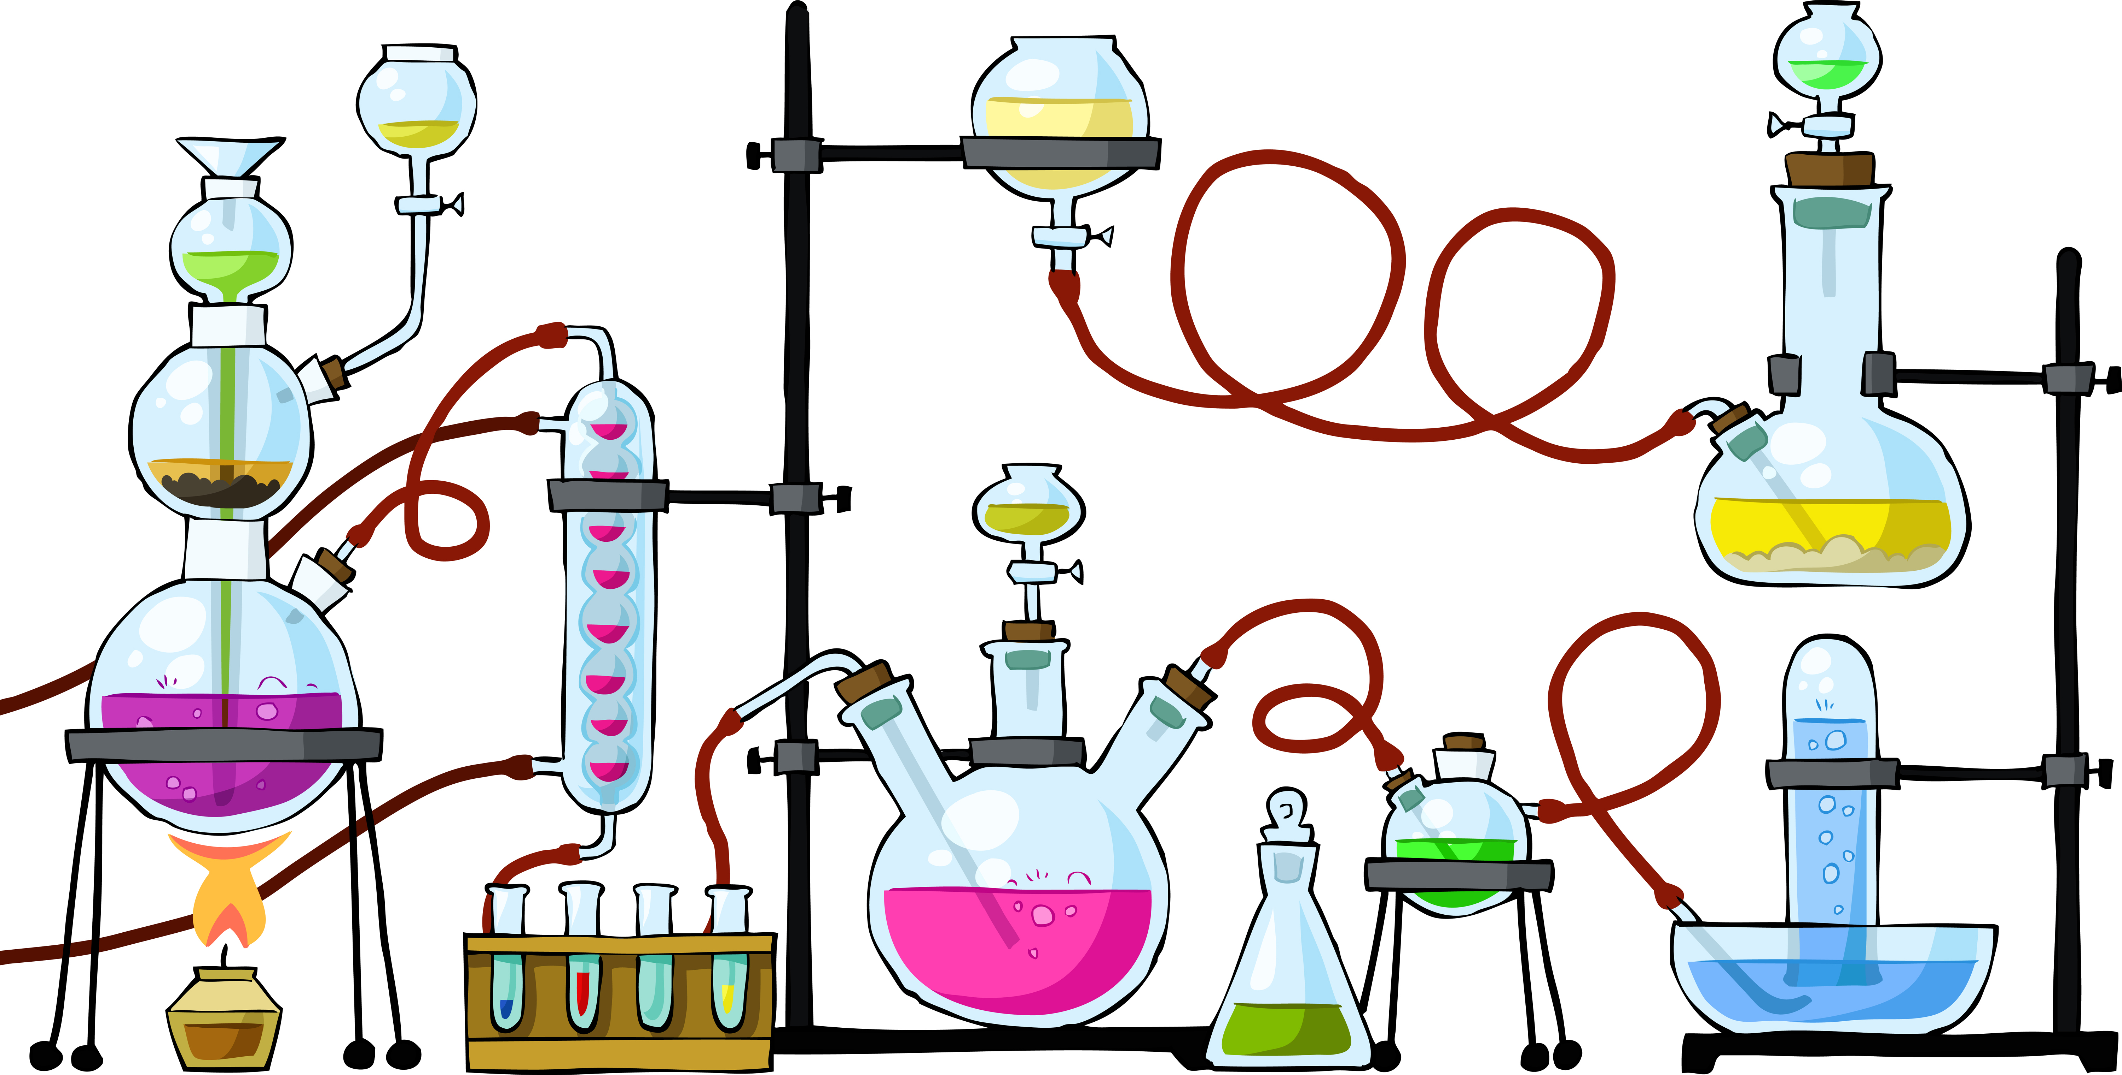
Solar energy
CO₂
Fossil
fuels

Slide 17

Solar energy
CO₂

Slide 18



Solar energy
Fuels
Plastic
Chemicals

Slide 19
Solar energy
CO₂
Fuels
Plastic
Chemicals

